Slide 1
How to Build Trust Into 5G:
Midterm Presentation
Rahul Muthyam, Benjamin Stark, Gandhar Joshi, Marlon Schumacher, Nikhil Joshi

Slide 2
Outline
Introduction
Goals
Team Approach
Current Progress and Results
  Choices of Attestation Protocol
  Handover and Attestation Workflow
  Testbed Implementation
Future Plans

Slide 3
Introduction
5G is moving to a decentralized, autonomous network architecture
Decentralization involves sharing parts of 5G’s infrastructure with third parties
  Need a security system to verify the trust of the third parties
Remote attestation may be the solution
  Protocol asks device to send info to verifying agent
  Agent verifies device’s integrity based on info

Slide 4
Goals
Figure out how to implement mutual remote attestation into 5G network
Figure out how to implement attestation in roaming/handover use case

Slide 5
Team Approach
We are using Docker + Open5GS + UERANSIM testbed
  Simulates the 5G network
  Used to implement workflows and protocols into 5G
We are using Wireshark to collect network information
Final product will be implementation of existing attestation protocol workflow in handover/roaming scenario
  Should work smoothly and securely in decentralized 5G network
  Should guarantee accurate verification of trust

Slide 6
Current Progress and Results
Created flow-diagrams to illustrate how remote attestation would be implemented in the handover test case
Created a testbed using Open5GS and UERANSIM
Implemented Wireshark into the testbed

Slide 7
Choices of Attestation Protocol
Collective Remote Attestation (CRA) Protocol
Uses unique measurement that obtained from an entire network of IoT devices
  Used to describe the collective status of whole network
  Can also provide status of each device in the network
Main advantage: Easily scalable for larger networks
Disadvantage: Must identify whether an attestation scenario was caused by either intermittent connections or compromised devices

Slide 8
Choices of Attestation Protocol-Contd
Authentication and Key Agreement (AKA) Protocol
Main Advantages:
  Is standardized for 5G network
  Is one of the primary defined authentication methods
Goals:
  Mutually authenticate subscribers and their carriers
  Establish secure channel to protect subsequent communication
We ultimately chose this protocol for testing

Slide 9
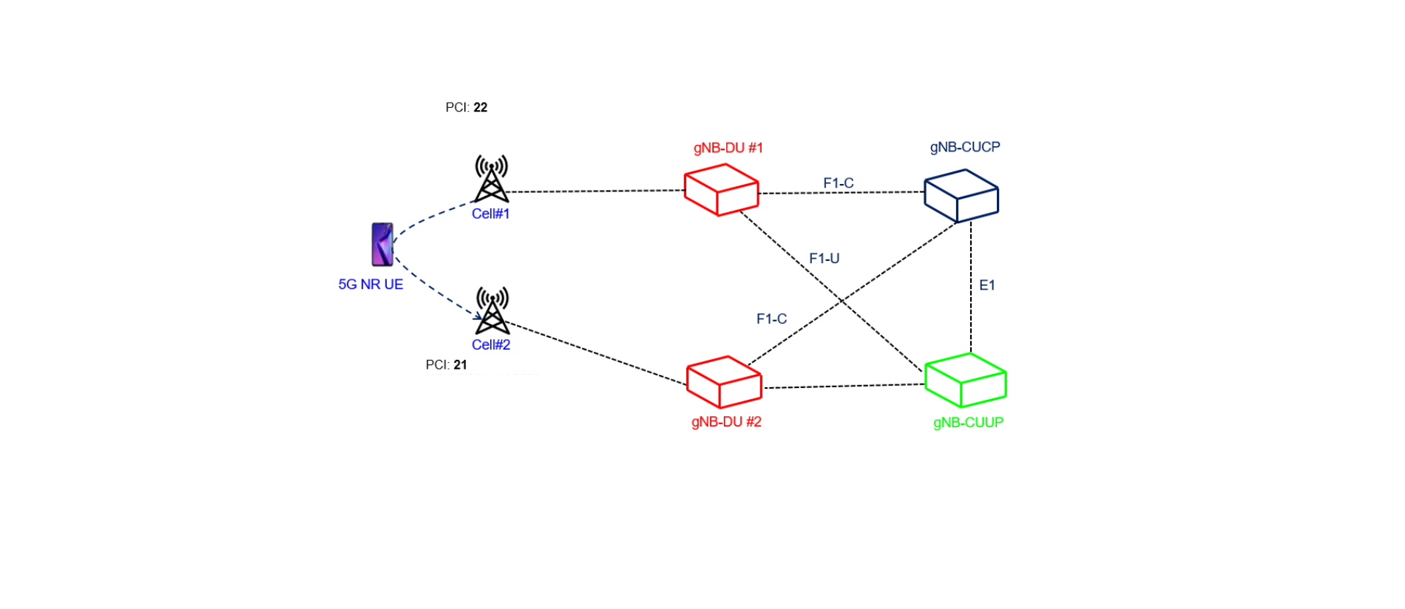
Handover and Attestation Workflow

Slide 10
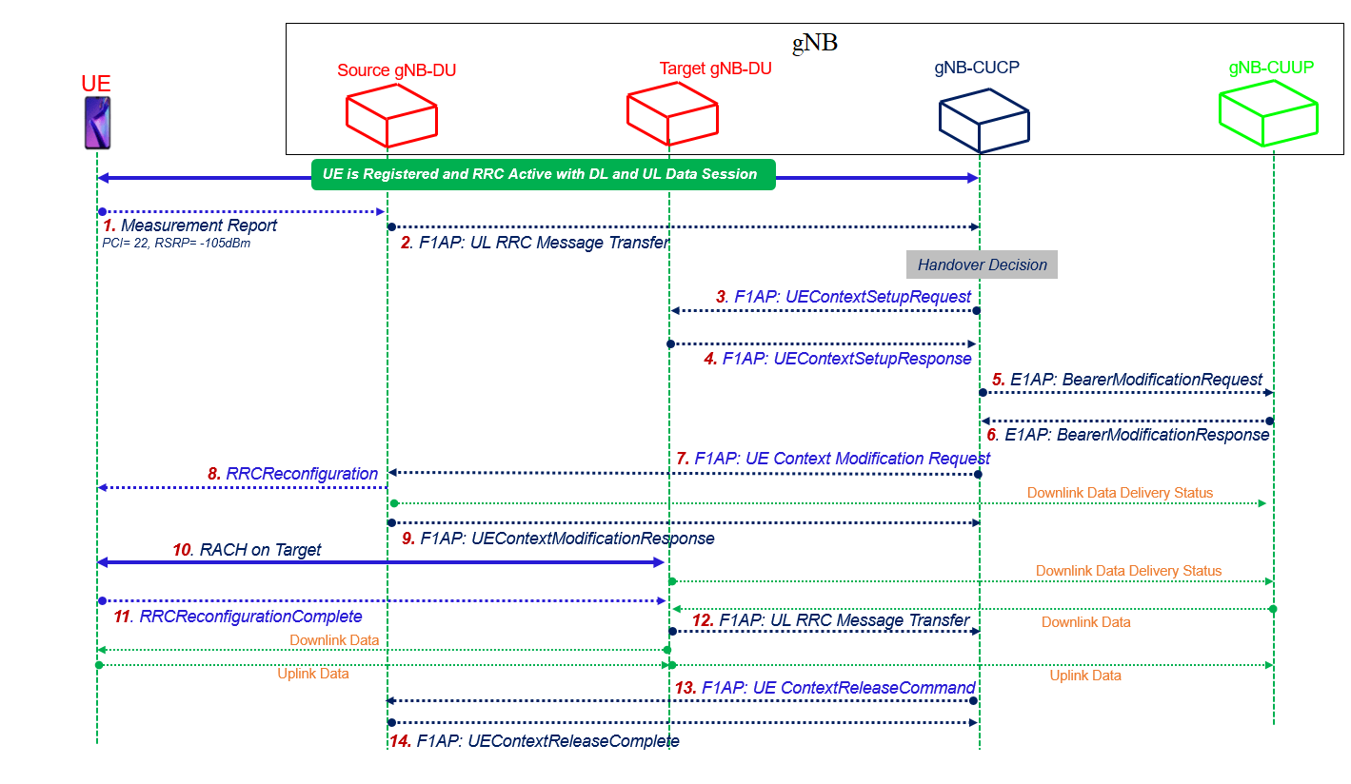
Handover and Attestation Workflow

Slide 11
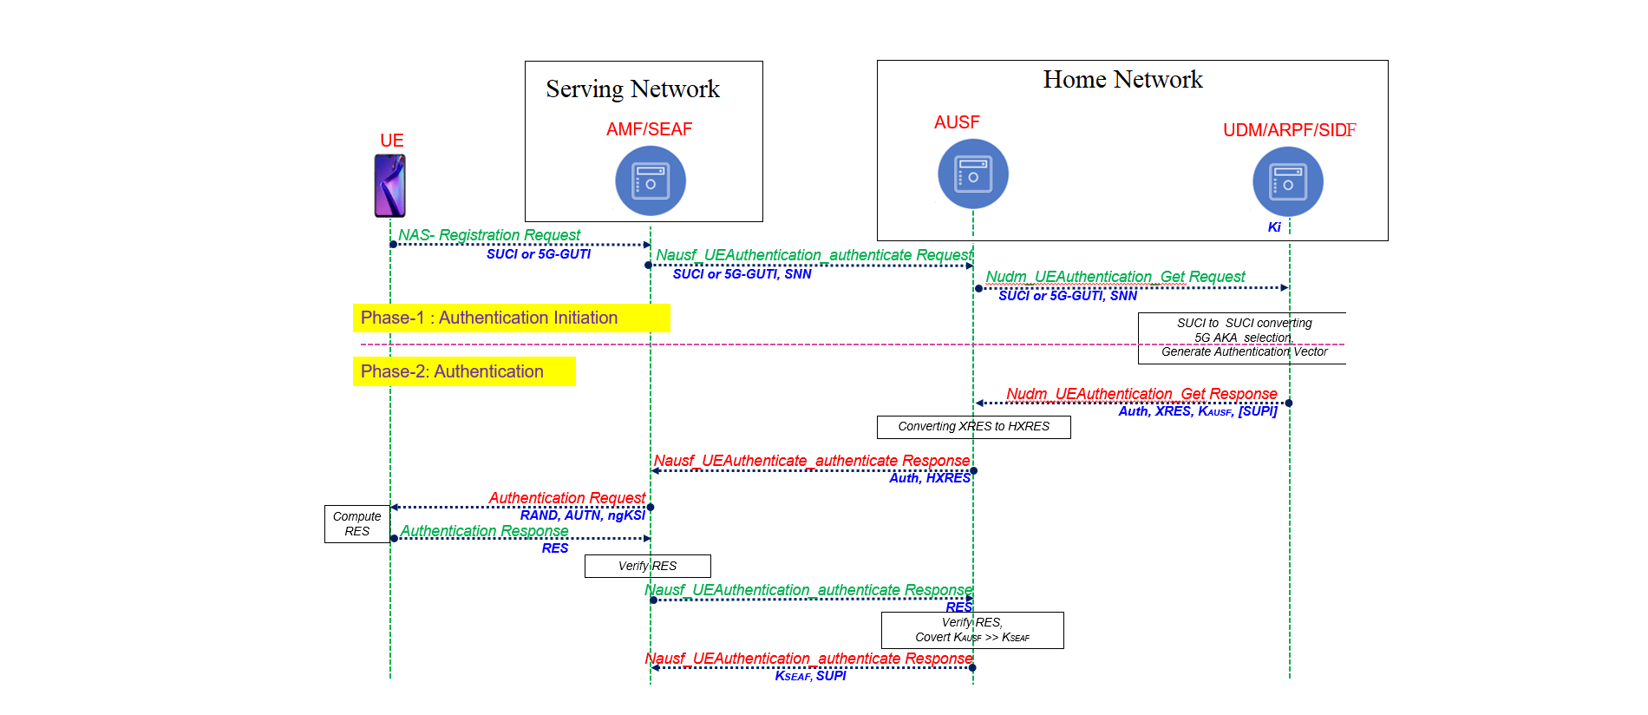
AKA Protocol Diagram

Slide 12
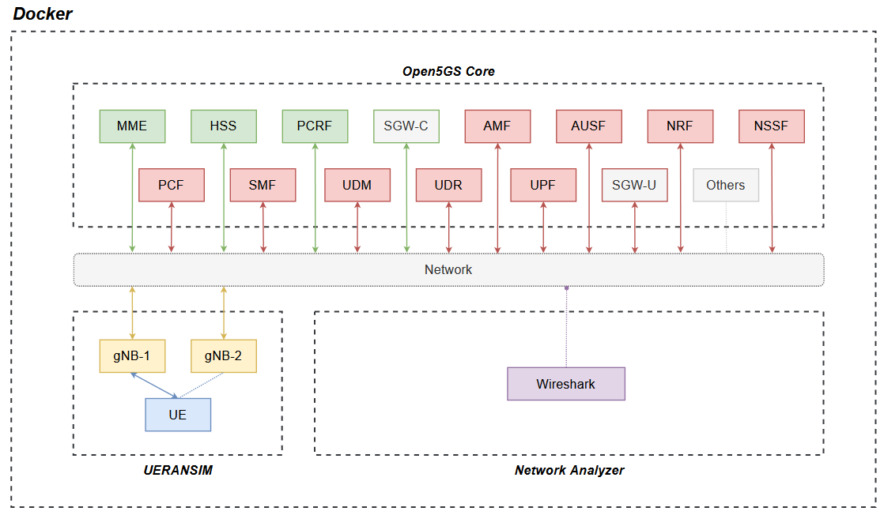
5G Testbed

Slide 13
Future Plans
Map functionalities from handover diagrams to testbed implementation diagram
Implement handover scenario
Implement attestation protocols into handover use case
Migrate the testbed from Docker to Kubernetes
Report on our research findings

Slide 14
Questions?

